Slide 1
EXIT SURVEY CLASS OF 2019

Slide 2
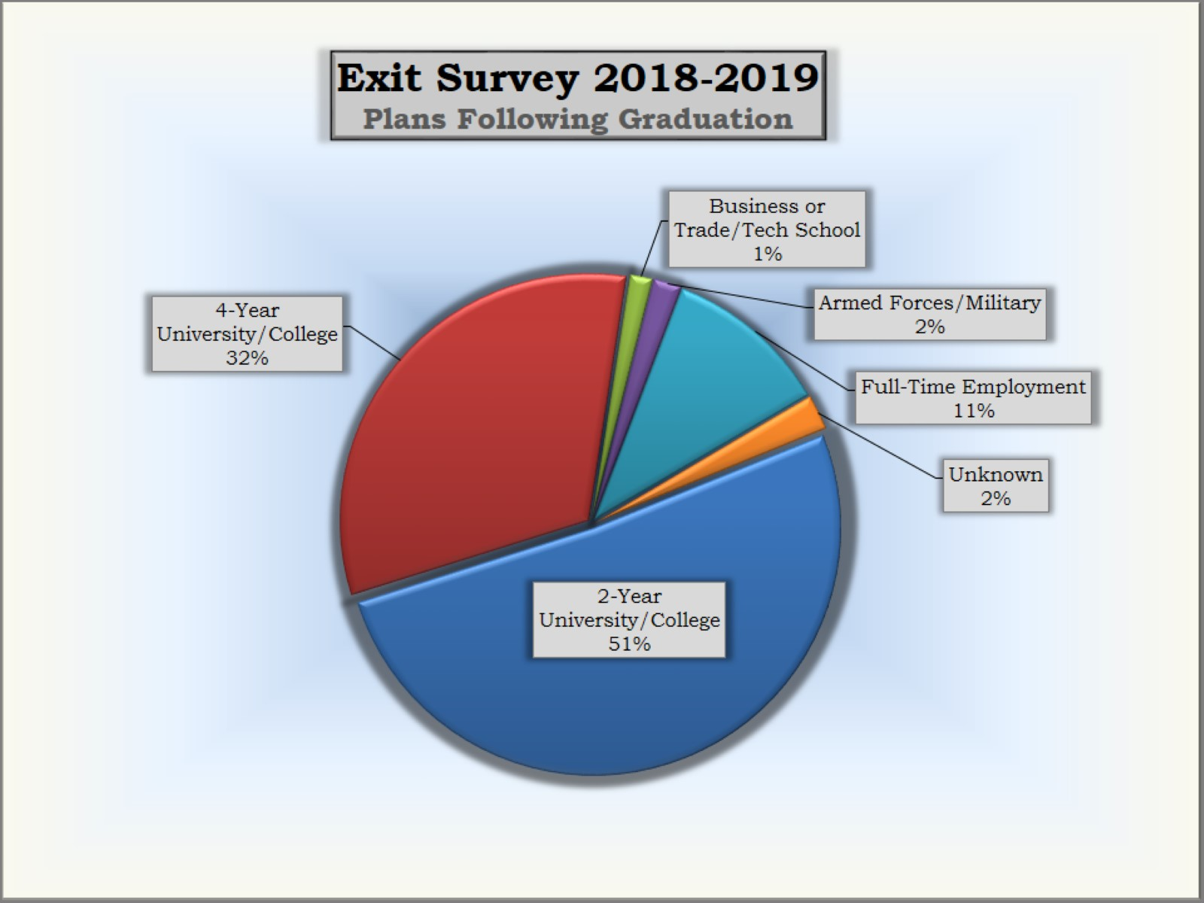

Slide 4
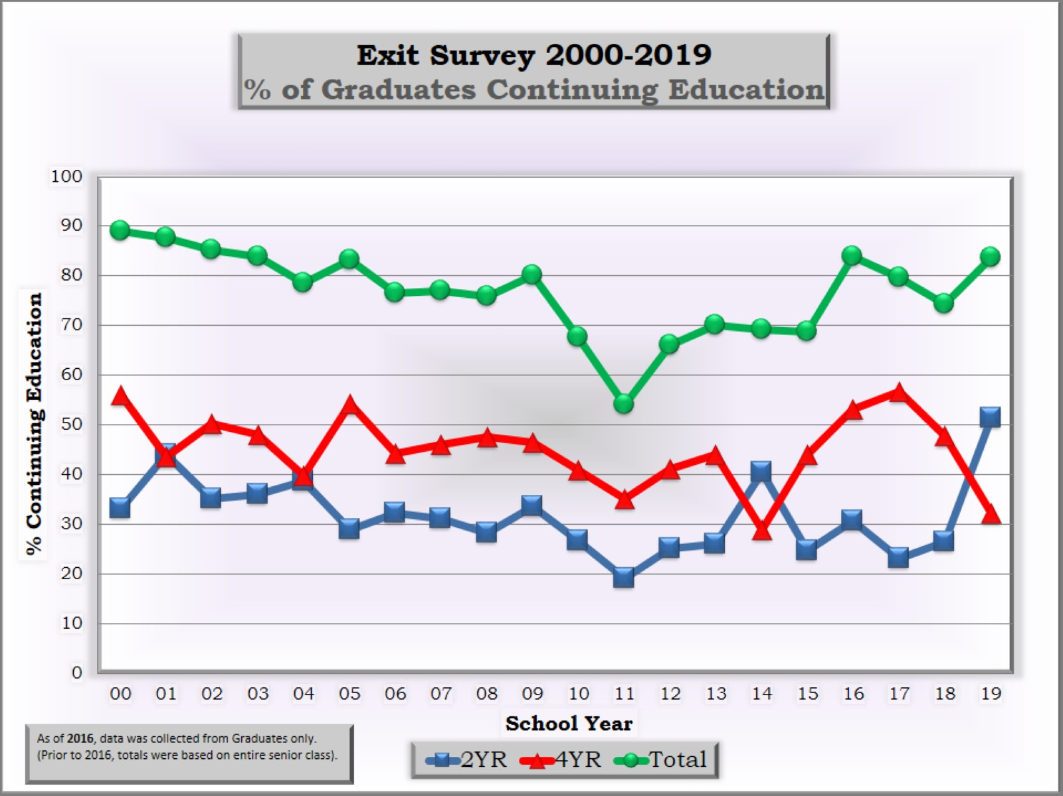

Slide 5
