Slide 1
CH. 6 Performing Basic Vehicle Maneuvers

Slide 2
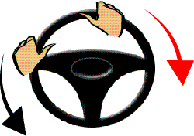
What is the difference between oversteering and understeering? (p.110)
Oversteer= Turn steering wheel too much.
Understeer= Don’t turn the steering wheel enough.

Slide 3
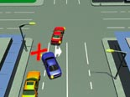
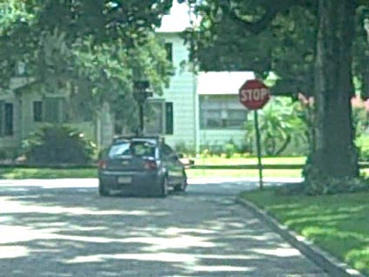
Signaling
2. Develop the habit of signaling every time you plan to turn, change lanes, slow or stop as well as pull over or pull out of a spot. .
At least 100 feet before turning in a residential area
And at least 200 feet in the country or traveling fast.

Slide 4
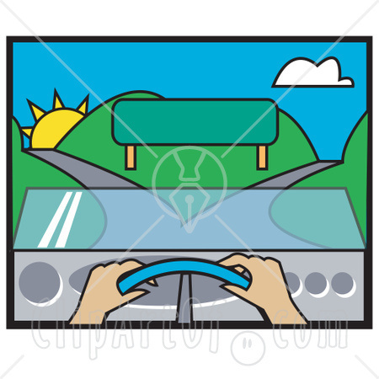
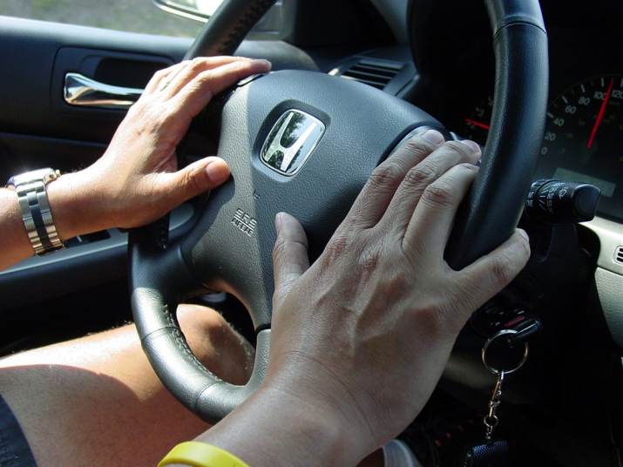
Steering
3. What are the two types of steering that are explained on page 113?
Hand over hand steering
Push and Pull steering

Slide 5
3) Steering- Hand over Hand (Hands at 10/2, 9/3, 8/4)

Slide 6
3) Steering- Push-Pull

Slide 7
4. What is a turnabout? (p.116)
A maneuver for turning your vehicle around.

Slide 8
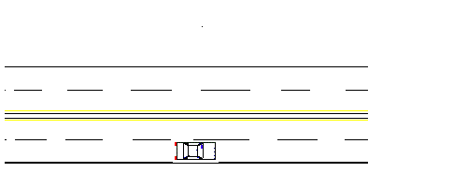
5. name the five types of turnabouts explained on pages 116-118…
Midblock U-turn

Slide 9
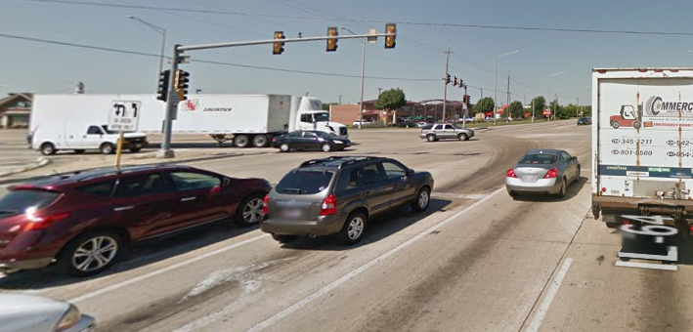
Can you legally make a U-turn in these situations?

Slide 10
Back into Driveway right side

Slide 11
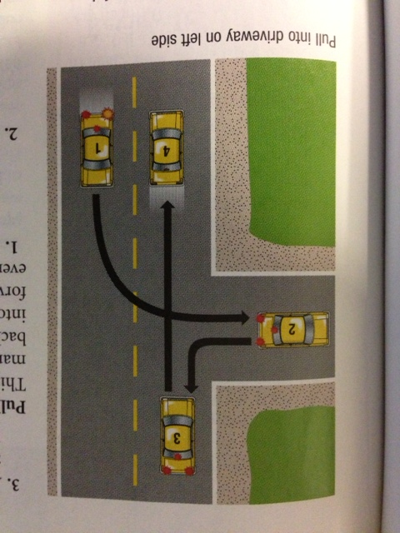

Slide 12
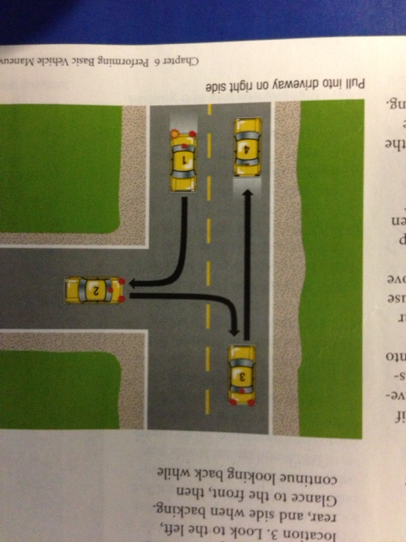

Slide 14
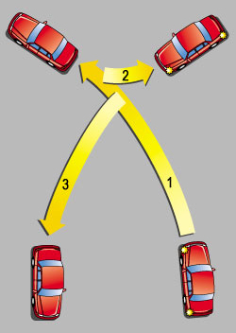

Slide 16
6. List six factors that should help you decide which turnabout to use (p.118)
Legality of the turnabout
Amount of traffic
Types of driveways available
Need to enter traffic lanes forward or backward
Ample space to enter traffic
Number of traffic lanes to cross.

Slide 17
Classwork
CH 6.1 #3
And draw a picture of a proper lane change!
CH 6.2 #3&4
CH 6.3 #3 (Draw a picture for all 4 parks! Show which way your wheels should face)
Draw a 3pt turn, 2pt turn, 2pt/back in turn and a U-Turn.

