Slide 1
ACCESS RESULTS

Slide 2
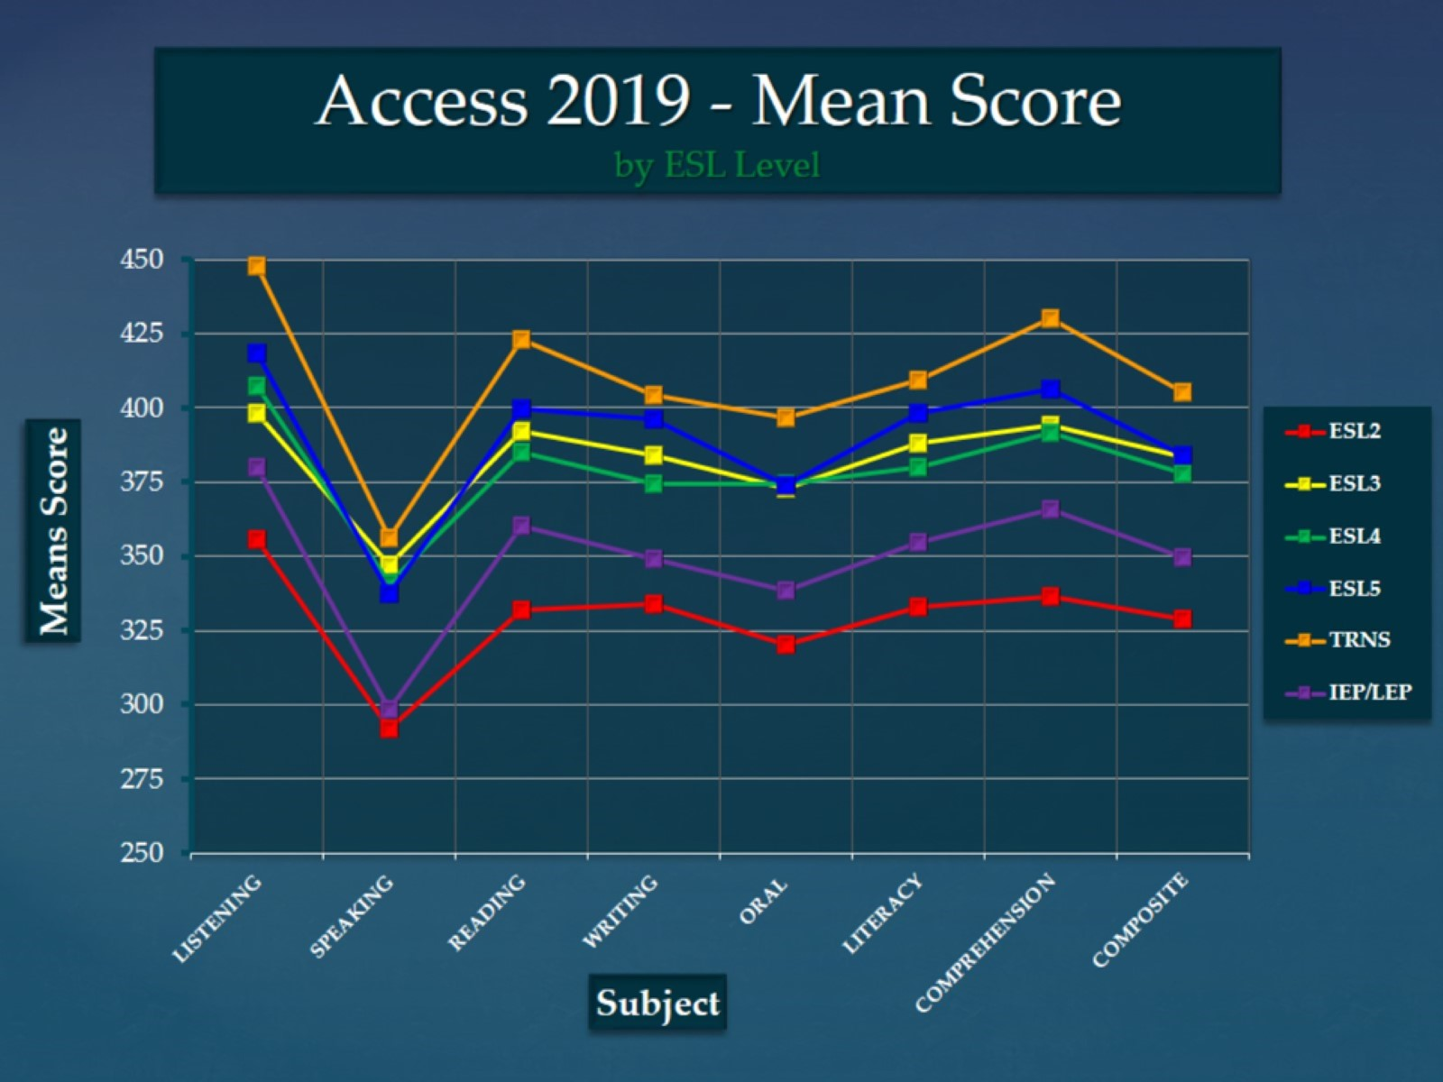
Access 2019 - Mean Score by ESL Level

Slide 3
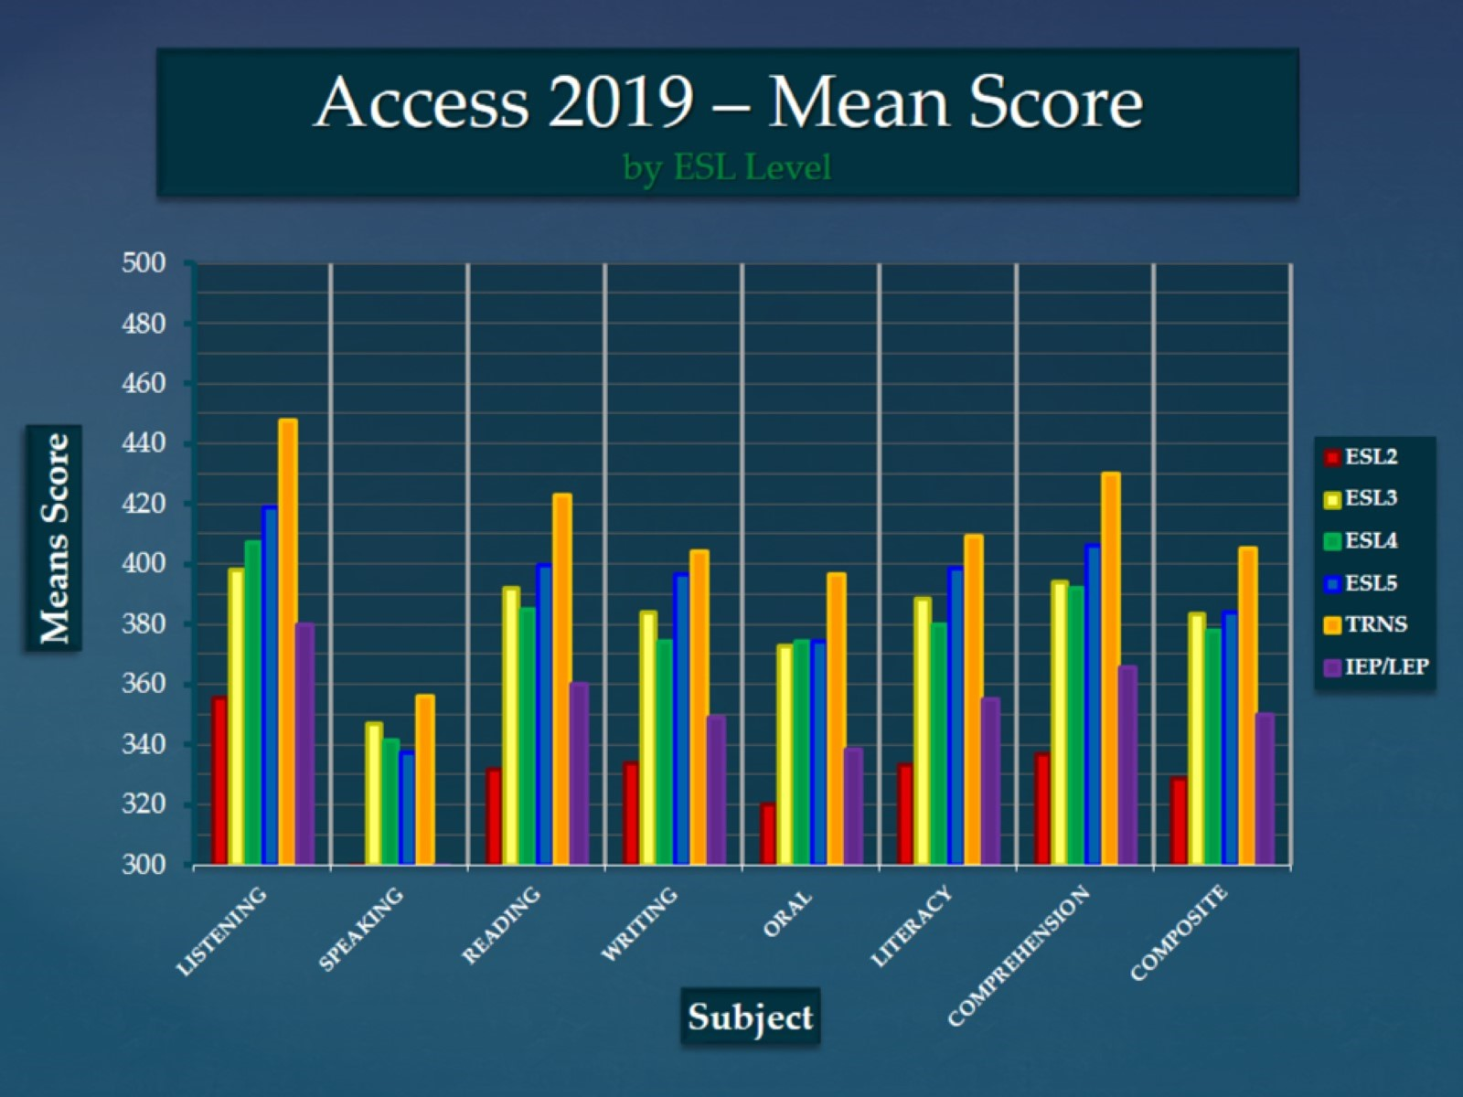
Access 2019 – Mean Score by ESL Level

Slide 4
Access 2019 – Score Comparison School Year 2015-2019

Slide 5
Access Level New* Students 14/15 to 18/19

Slide 6
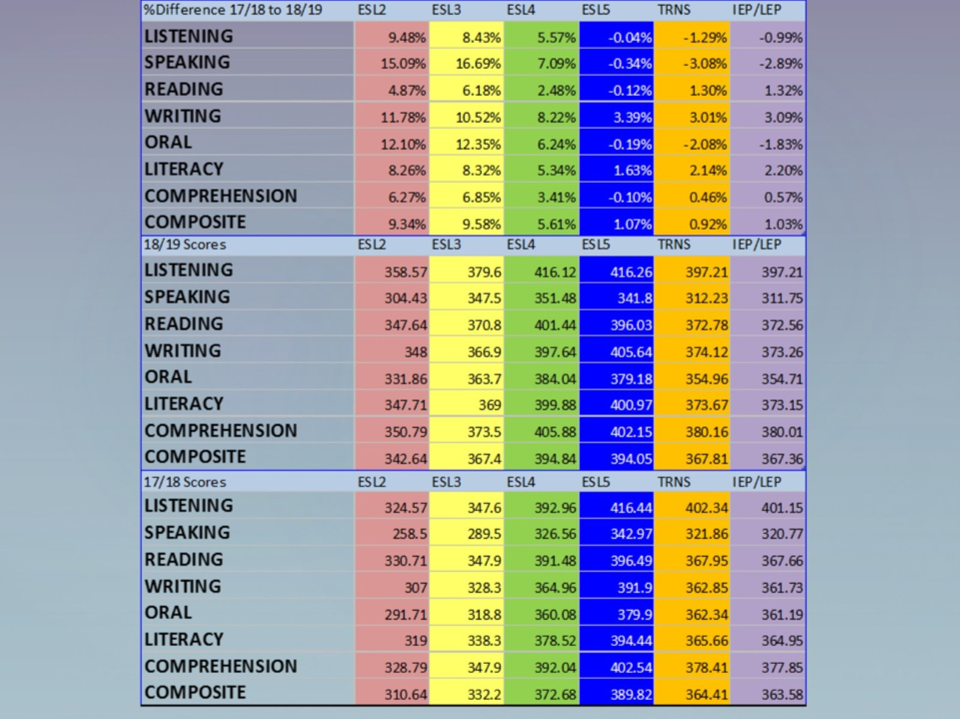

Slide 7
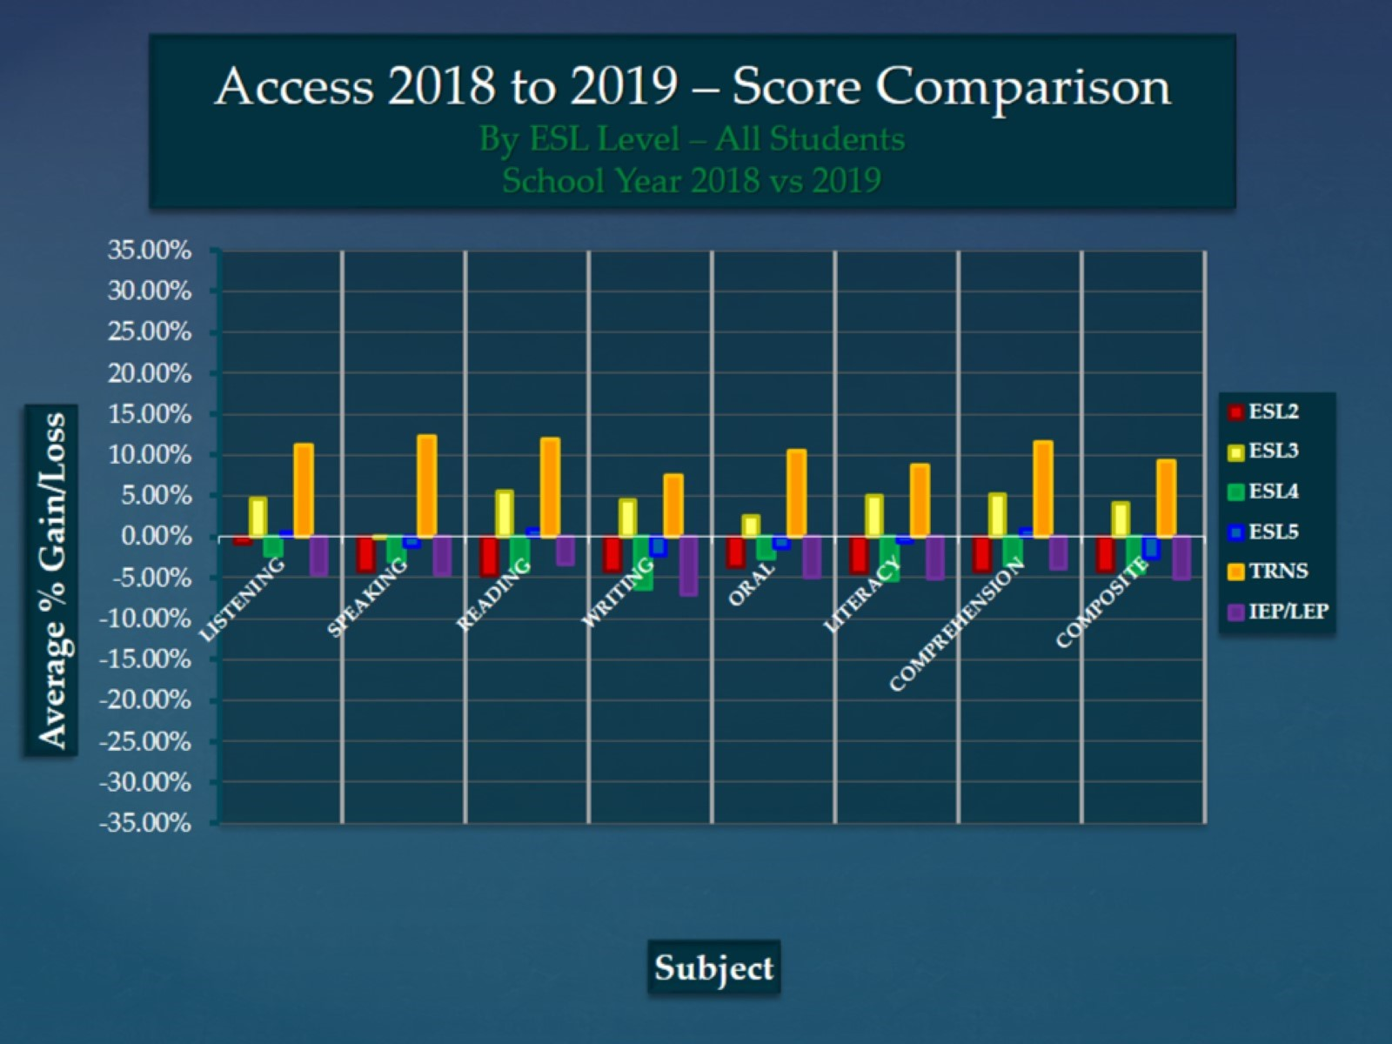
Access 2018 to 2019 – Score Comparison By ESL Level – All Students School Year 2018 vs 2019

Slide 8
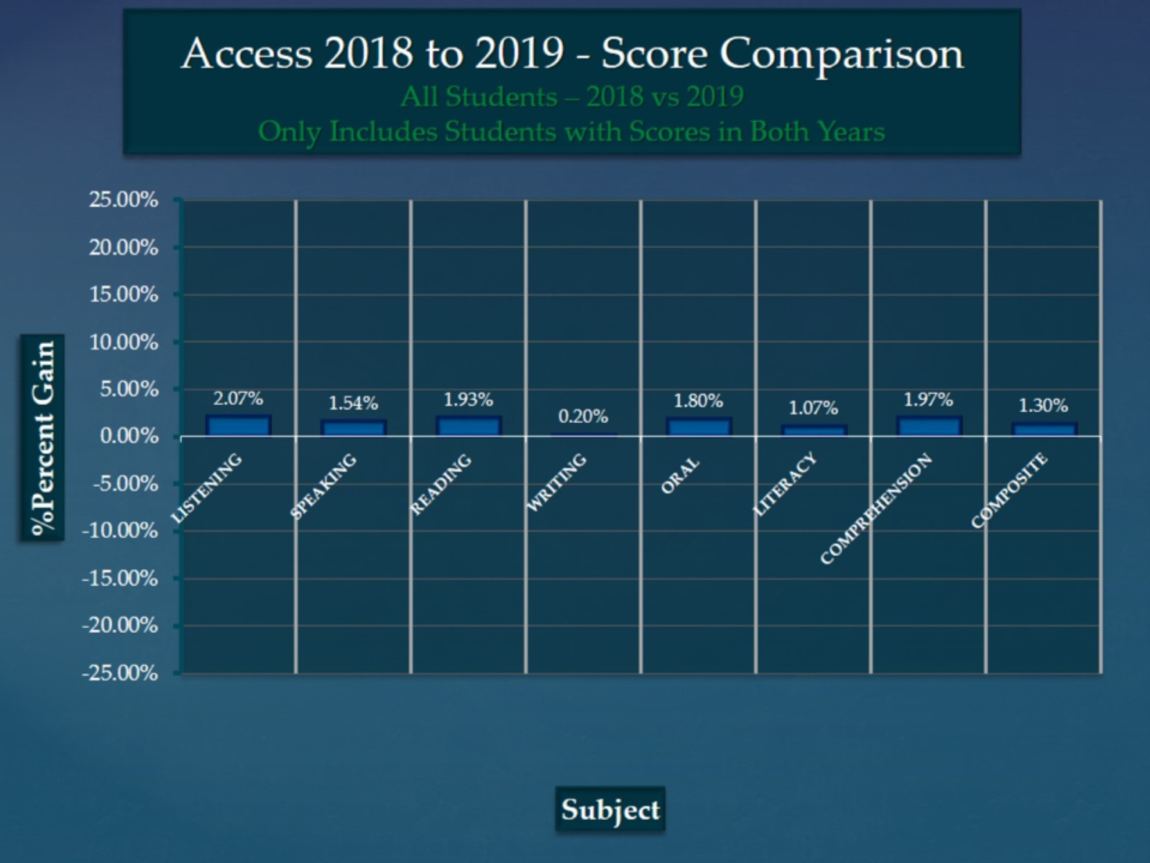
Access 2018 to 2019 - Score Comparison All Students – 2018 vs 2019 Only Includes Students with Scores in Both Years

